Slide 1

Risk & Return
Dr. Naresh Chandra Sahu
Associate Professor (Economics)
School of Humanities, Social Sciences & Management
Indian Institute of Technology, Bhubaneswar

Slide 2

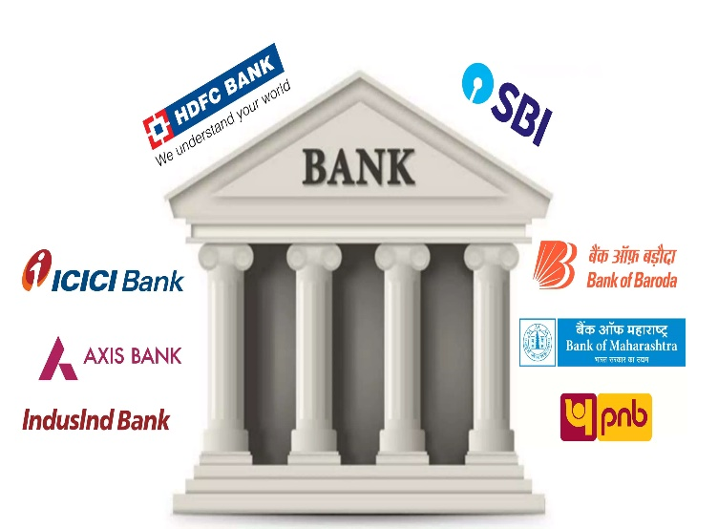
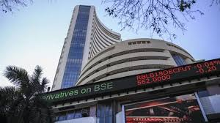


You were given Rs. 1,00,000…..

Slide 3
Risk-Return Relationship of Different Financial Assets
Market Line E(r)
Risk
Premium
Equity shares
Preference shares
Rate of
Return
Unsecured Loan/Debentures
Secured Loan/Debenture
Mortgage loan
T-bill or Government Bond (risk-free)
Degree of Risk
Risk return relationship of different stocks

Slide 4


Slide 5
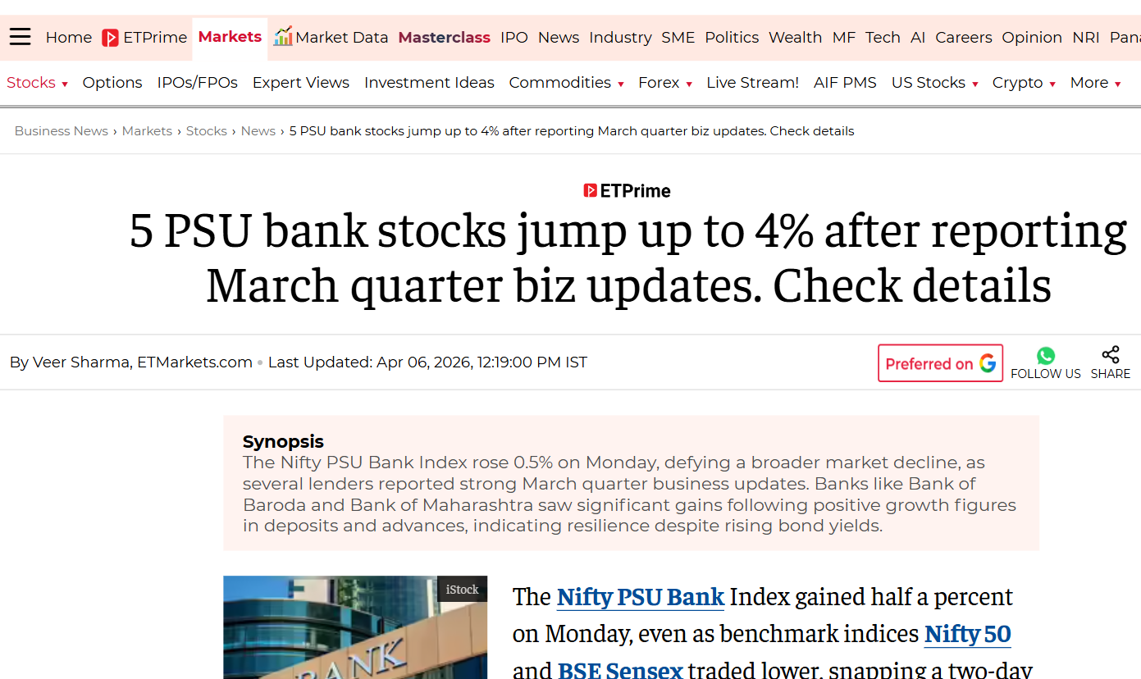
Source: The Economics Times, April 6 (2025)

Slide 6

Learning Objectives
Understand the concept of return and risk of a security.
Calculate return of a security.
Compare different investment alternatives in terms of various returns.
Differentiate between systematic and unsystematic risk.
Estimate total risk, systematic risk and unsystematic risk on a security.
Calculation beta of a security and its significance.

Slide 7
Introduction to Risk and Returns
Investment refers to commitment of funds in expectation of future gains or benefits.
Every investment requires that current consumption is foregone so that in future some benefits or returns are generated.
A person may defer his present consumption and invests the amount in securities (such as equity shares, bond or debentures) expecting that his investment would provide him revenue returns (in the form of interest and dividends) in future.
A businessman invests in plants and machinery in expectation of making profits (or returns).
A person puts the money in a fixed deposit account now so that he can get a higher amount including interest incomes in future.
Therefore the primary motivating or driving force of an investment is the reward attached with it popularly known as RETURN.

Slide 8
Introduction to Risk and Returns
However, there is always a possibility that the actual return may not be same as the expected or desired return.
This may be due to a number of factors such as changes in the economic environment, financial crisis, global slowdown, poor performance of the company etc.
Hence there is always a RISK attached with investment that the actual return will be different from the expected return.
Risk is defined as the variability in expected returns. It must be noted that no investment is risk free (except the hypothetical risk-free asset).
Returns and risks move together.
An investor can have higher returns only when he is willing to undertake higher risk.

Slide 9
Introduction to Risk and Returns
Therefore, based of risk profile, different financial assets have different expected rate of return.
Like T-bills are called risk-free assets as they carry zero risk, debentures are moderately risky and equity shares are highly risky.
Therefore, every investment decision requires careful analysis of Return and Risk.

Slide 10
Returns
Return may be defined as total income (or cash inflows including price change) generated by investment expressed as a percentage of the cost of investment.
Return from a financial asset :
$$Return=\frac{Income from Assets+(Selling Price−Purchase Price) }{Purchase Price}∗100$$

Slide 11
Returns from equity
There are two components of Return on an equity share - Dividend yield and Capital gain. Dividend yield is that part of return which is due to cash inflows in the form of dividend. Capital gain is that part of total return which arises due to change in price.
Hence it may be calculated as:
$$Return=\frac{Dividend+(Price Year 1− Price at Year 0) }{Purchase Price}∗100$$

Slide 12
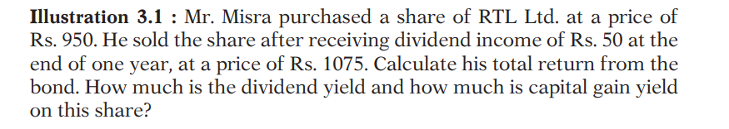
Returns from equity
Question

Slide 13
Returns from bond
There are two components of Return on a bond - Interest yield and Capital gain. Interest yield is that part of return which is due to cash inflows in the form of interest. Capital appreciation is that part of total return which arises due to change in price.
Hence it may be calculated as:
$$Return=\frac{Interest+(Price Year 1− Price at Year 0) }{Price at Year 0}∗100$$

Slide 14
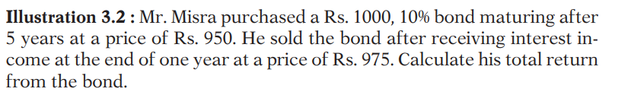
Returns from bond
Question

Slide 15
Types of returns
Different types of returns are:
Holding Period Returns
Annualized Returns
Expected Returns
Risk-adjusted Returns
Average Returns

Slide 16
Holding period returns (HPR)
Holding period return is the total return earned during the holding period of investment.
Holding period is also termed as investment horizon.
If the holding period is one year, then the holding period return is same as the total return calculated using equation.
If an investor holds investment for more than one year then we may calculate its holding period return as the total income plus price change during the holding period expressed as a percentage of purchase price.

Slide 17
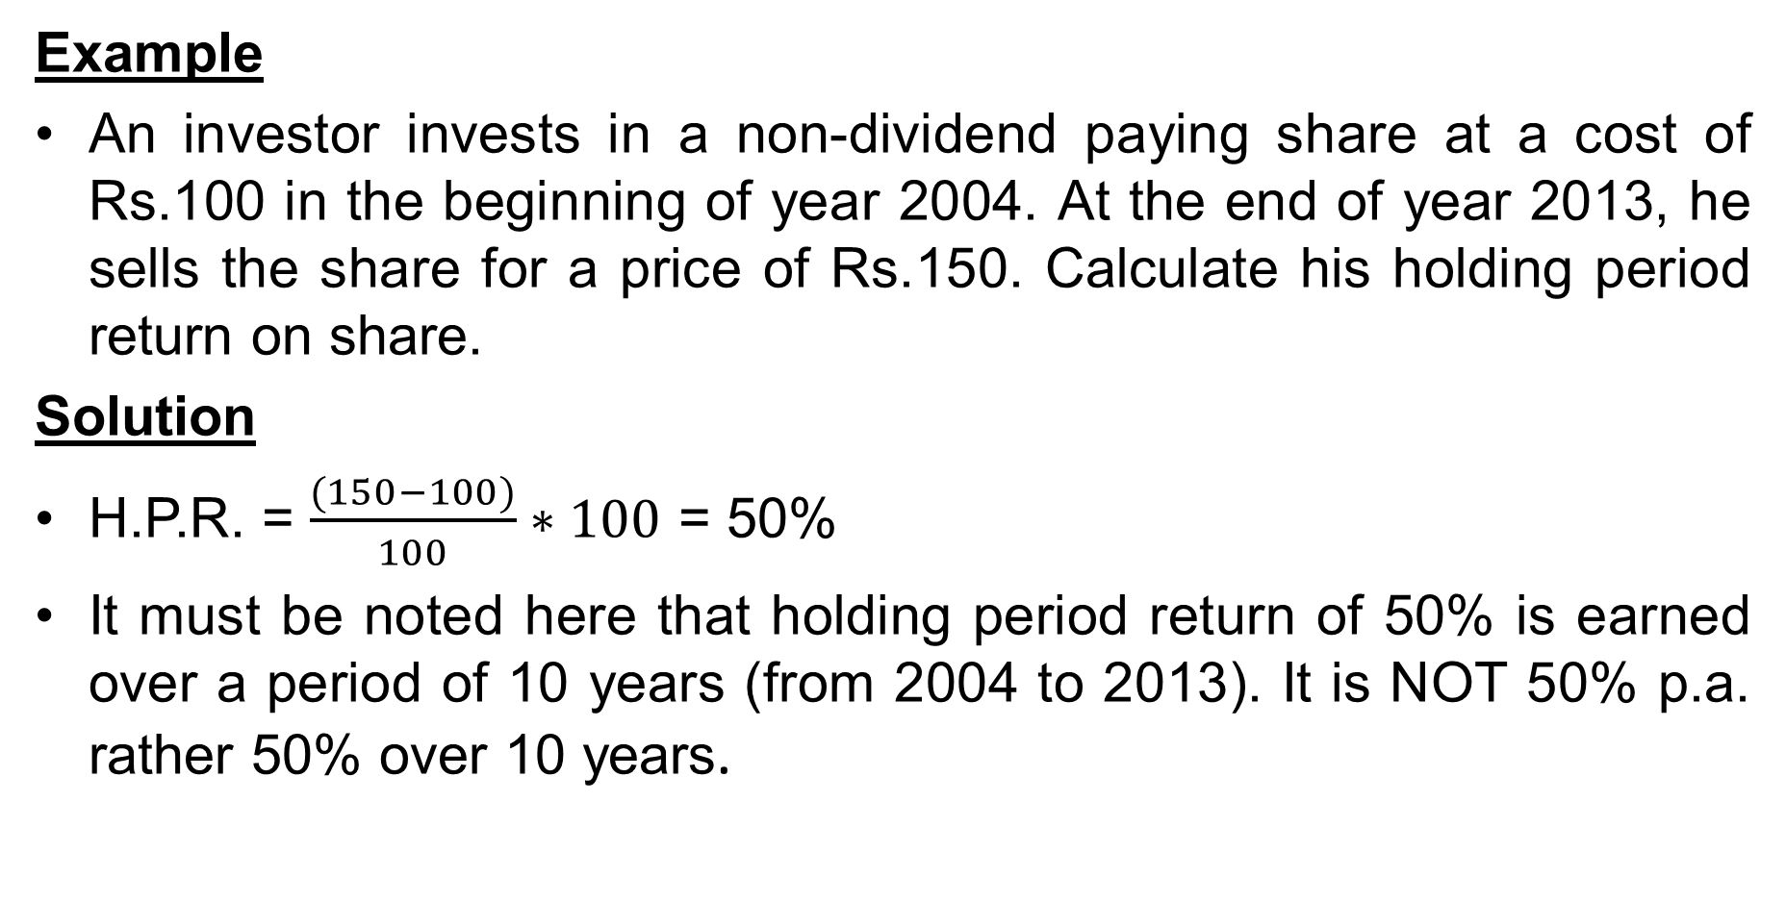
Holding period returns (HPR)
Example
An investor invests in a non-dividend paying share at a cost of Rs.100 in the beginning of year 2004. At the end of year 2013, he sells the share for a price of Rs.150. Calculate his holding period return on share.
Solution
H.P.R. = $\frac{(150−100)}{100}∗100$ = 50%
It must be noted here that holding period return of 50% is earned over a period of 10 years (from 2004 to 2013). It is NOT 50% p.a. rather 50% over 10 years.

Slide 18
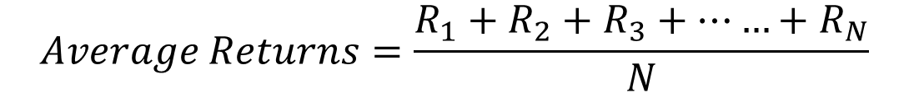
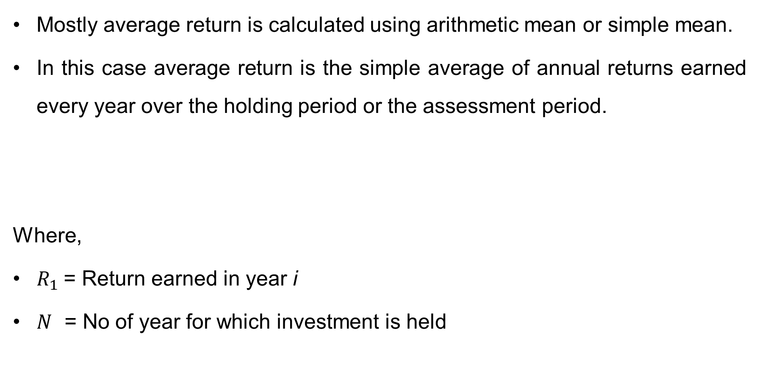
Average returns
Mostly average return is calculated using arithmetic mean or simple mean.
In this case average return is the simple average of annual returns earned every year over the holding period or the assessment period.
Where,
$R_{1}$= Return earned in year i
$N$ = No of year for which investment is held
$$Average Returns=\frac{R_{1}+R_{2}+R_{3}+……+R_{N}}{N}$$

Slide 19
Average returns
EXAMPLE
Mr. X wants to calculate average return of a share of RPL Ltd, currently available at a price of Rs.160 as on 31st December, 2013. The share did not pay any dividend over these years. Calculate average return of RPL Ltd.’s shares.
Year | Price
31st December, 2008 | 100
31st December, 2009 | 118
31st December, 2010 | 130
31st December, 2011 | 120
31st December, 2012 | 140
31st December, 2013 | 160

Slide 20
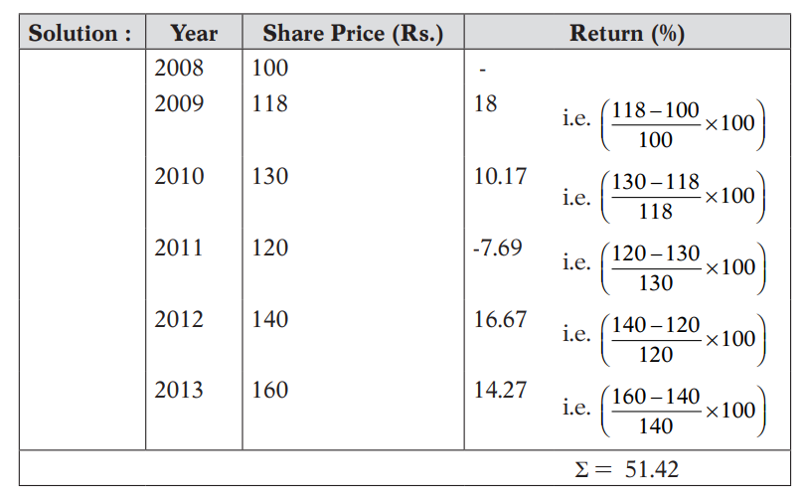

Average returns
Average Return $=\frac{51.42}{5}=10.28\%$
Thus, on the basis of historical data the average annual return on RPL Ltd share has been 10.28%.

Slide 21
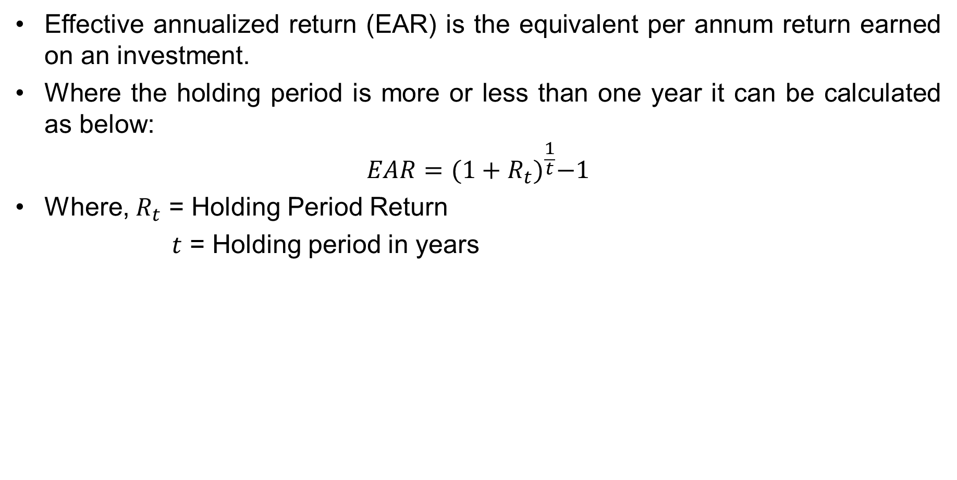
Annualized returns
Effective annualized return (EAR) is the equivalent per annum return earned on an investment.
Where the holding period is more or less than one year it can be calculated as below:
$$EAR={(1+R_{t})}^{\frac{1}{t}}−1$$
Where, $R_{t}$ = Holding Period Return
$t$ = Holding period in years

Slide 22

Annualized returns
EXAMPLE
If an investor, who earns 50% return over a period of 10 years has actually earned 4.13% p.a. as calculated below:
EAR = ${(1+0.50)}^{\frac{1}{10}}−1$ = 1.0413 − 1 = 0.0413 or 4.13% p.a.

Slide 23
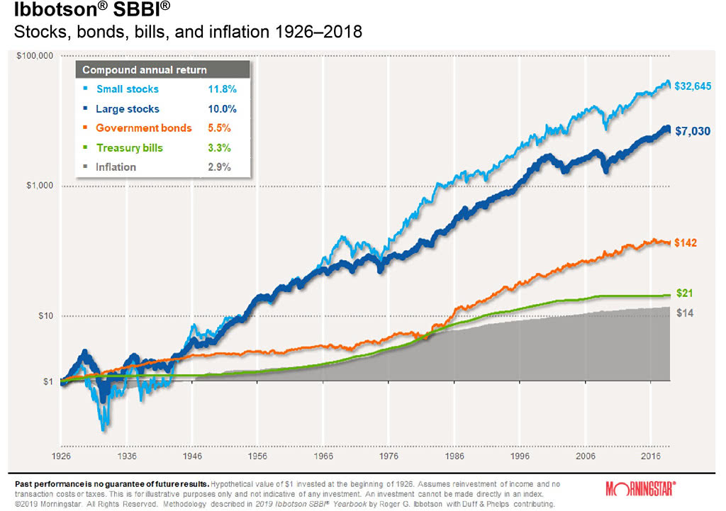
Historical returns

Slide 24
Expected returns
Average return based on a series of historical returns may not be useful in making future predictions about expected returns.
Therefore, an investor may have a number of probable returns and assign probabilities to each expected outcome.
Security analysts can actually construct a probability distribution of returns by assigning probabilities to the expected return outcomes.
Based on this probability distribution, they can then calculate single expected return by using the following formula of statistics :

Slide 25
Expected returns
EXAMPLE
if we are given that the expected return from a share depends upon the state of the economy (Good, Normal or Bad) and we are given the following probability distribution.
In such a case the Expected Return of the share will be calculated as
Expected Return = 18*(0.4) + 15*(0.3) -5*(0.3) = 10.2%
State of the economy | Return | Probability
Good | 18% | 0.4
Normal | 15% | 0.3
Bad | -5% | 0.3

Slide 26
Risk-adjusted returns
-No risk, No return.
A risk-adjusted return is a calculation of the return or profit from an investment that takes into account the degree of risk.
The risk-adjusted return measures the profit your investment has made relative to the amount of risk the investment has represented throughout a given period of time.
For example, If two or more investments deliver the same return over a given time period, then one that has the lowest risk will have a better risk-adjusted return and vice-versa.
Some common risk measures used in investing include beta, standard deviation, etc.

Slide 27
Risk-adjusted measures of portfolio analysis
Figure 1
Figure 2
A better than B
C better than D
20%
A
C
D
Returns
15%
B
20%
Returns
10%
10%
15%
Risk
Risk

Slide 28
Risk-adjusted measures of portfolio analysis
Some of the popular risk-adjusted measures are:
Sharpe ratio
Treynor’s ratio
Jensen’s alpha

Slide 30

Risk
The total variability in returns of a security represents the total risk of that security.
Systematic risk and unsystematic risk are the two components of total risk.
However, in financial management, risk relates to any material loss attached to the project that may affect the productivity, tenure, legal issues, etc. of the project.
In finance, different types of risk can be classified under two main groups.
Total risk
= Systematic risk + Unsystematic risk

Slide 31
Measurement of Risk
Risk is defined as the variability in expected returns.
Therefore total risk on a security can be measured by using statistical methods of measuring variability or dispersion such as:
Range,
Standard Deviation (S.D) or Variance.
Coefficient of Variation

Slide 32
Measurement of Risk
Range as Risk
Range is the difference between highest and lowest possible return in case of an investment.
The higher the Range the greater will be the dispersion and higher will be the risk.
This may not be a good measure of risk because it does not provide a single estimate of Risk.

Slide 33
Range as Risk
Question
Calculate range of returns of the security for which past returns are given below
Year | Returns (%)
1 | 10
2 | 12
3 | 8
4 | 5
5 | 10
6 | 13
7 | 7
8 | 5
9 | 8
10 | 12

Slide 34

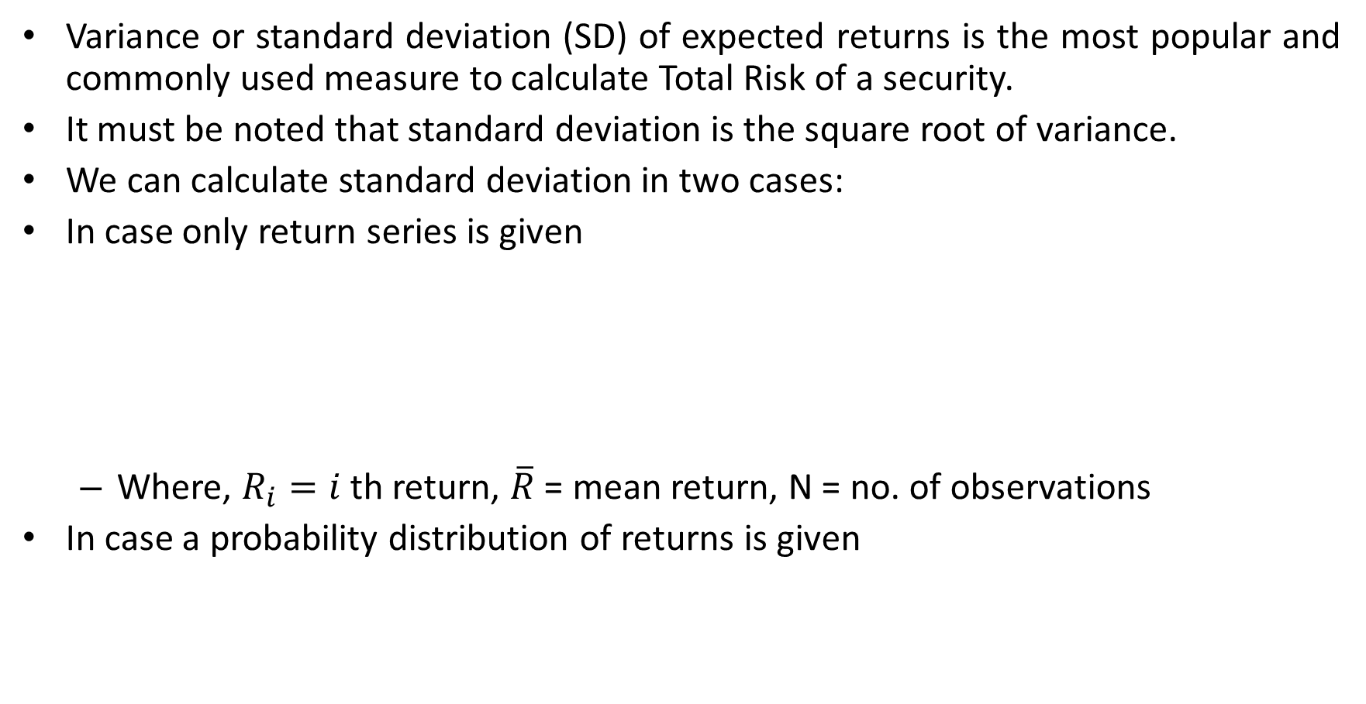
Standard Deviation or Variance as Risk
Variance or standard deviation (SD) of expected returns is the most popular and commonly used measure to calculate Total Risk of a security.
It must be noted that standard deviation is the square root of variance.
We can calculate standard deviation in two cases:
In case only return series is given
Where, $R_{i}=i$th return, $\overline{R}$= mean return, N = no. of observations
In case a probability distribution of returns is given
$$SD=\sqrt{\frac{\sum_{i=1}^{n}{({R_{i}−\overline{R})}^{2}}}{N}}$$
$SD=\sqrt{\sum_{i=1}^{n}{P_{i}({R_{i}−\overline{R})}^{2}}}$ or $Variance= \sum_{i=1}^{n}{P_{i}({R_{i}−\overline{R})}^{2}}$

Slide 35
Standard Deviation or Variance as Risk
Question
Calculate total risk of the security for which past returns are given below
Year | Returns (%)
1 | 10
2 | 12
3 | 8
4 | 5
5 | 10
6 | 13
7 | 7
8 | 5
9 | 8
10 | 12

Slide 36
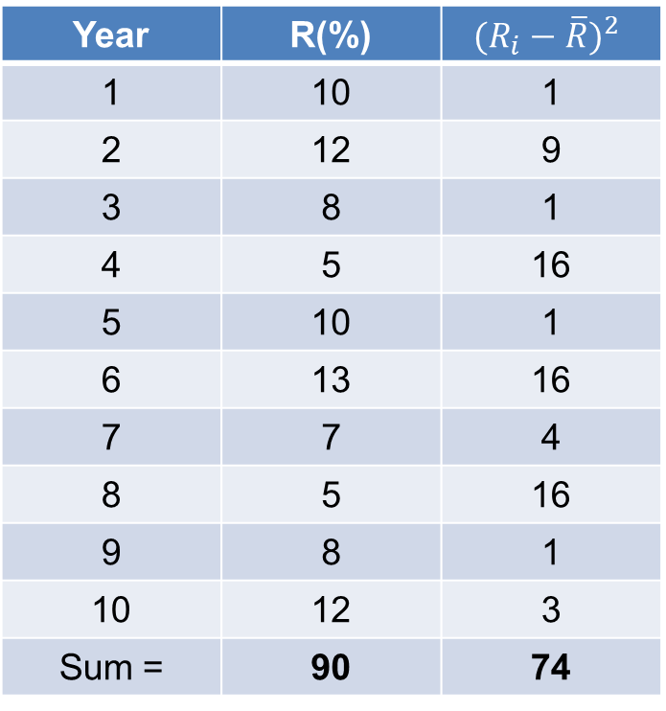

Standard Deviation or Variance as Risk
Solution
$\overline{R}$ = Mean returns = $\frac{90}{10}=9\%$
SD= $\sqrt{\frac{\sum_{i=1}^{n}{({R_{i}−\overline{R})}^{2}}}{N}}$ = $\sqrt{\frac{74}{10}}$ = $\sqrt{7.4}$ =2.72%
Hence the mean return on
security is 9% with a total risk of 2.72%
(or total variance is 7.4 squared percentages).
Year | R(%) | $$({R_{i}−\overline{R})}^{2}$$
1 | 10 | 1
2 | 12 | 9
3 | 8 | 1
4 | 5 | 16
5 | 10 | 1
6 | 13 | 16
7 | 7 | 4
8 | 5 | 16
9 | 8 | 1
10 | 12 | 3
Sum = | 90 | 74

Slide 37
Standard Deviation or Variance as Risk
Question
An investment analyst wants to analyze risk and return on security A for which he has constructed the following return distribution.
Calculate expected return and total risk.
Return (Ri) | Probability
20 | 0.1
15 | 0.2
-5 | 0.2
10 | 0.3
25 | 0.2

Slide 38
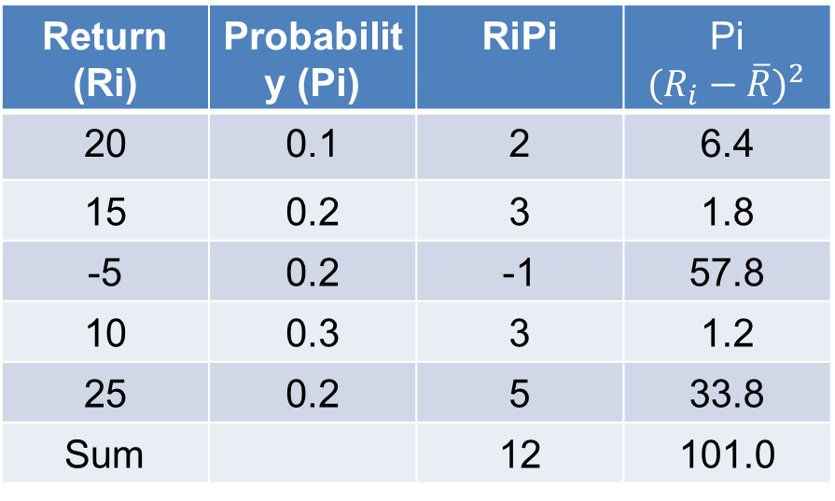

Standard Deviation or Variance as Risk
Solution
$\overline{R}$ = Expected returns = $\sum{RiPi=12\%}$
SD=$\sqrt{\sum_{i=1}^{n}{P_{i}({R_{i}−\overline{R})}^{2}}}$ = $\sqrt{101}$ = 10.05%
Hence security A has average return of 12% with a total risk of 10.05%. This security has very high risk due to very large variability in return (i.e. -5% to 25%)
Return (Ri) | Probability (Pi) | RiPi | Pi$({R_{i}−\overline{R})}^{2}$
20 | 0.1 | 2 | 6.4
15 | 0.2 | 3 | 1.8
-5 | 0.2 | -1 | 57.8
10 | 0.3 | 3 | 1.2
25 | 0.2 | 5 | 33.8
Sum |  | 12 | 101.0

Slide 39
Coefficient of Variation as a relative measure of Risk
The main limitation of standard deviation as a measure of total risk of a security is that it is an absolute measure of risk.
Therefore, when expected returns are same for two investments then their risks can be compared using S.D.
However, when we want to compare two or more securities having different average returns, we should not use S.D to conclude about the riskiness of securities.
In such case we should use coefficient of variation.
Coefficient of variation is a relative measure of risk.
It can be calculated as given below :
$$Coefficient of Variation (C.V.)=\frac{Standard Deviation (SD)}{Mean Returns}$$

Slide 40
Coefficient of Variation as a relative measure of Risk
Illustration
A security analyst wants to analyse the following two securities with respect to risk.
Can it be concluded that security B is more risky than security A?
Security | Expected Returns (%) | S.D. of Returns (%)
A | 20 | 15
B | 30 | 18

Slide 41
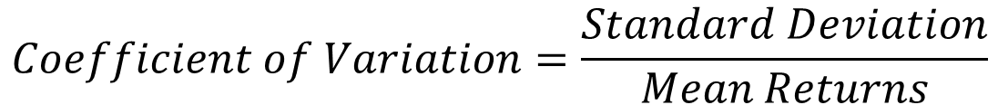
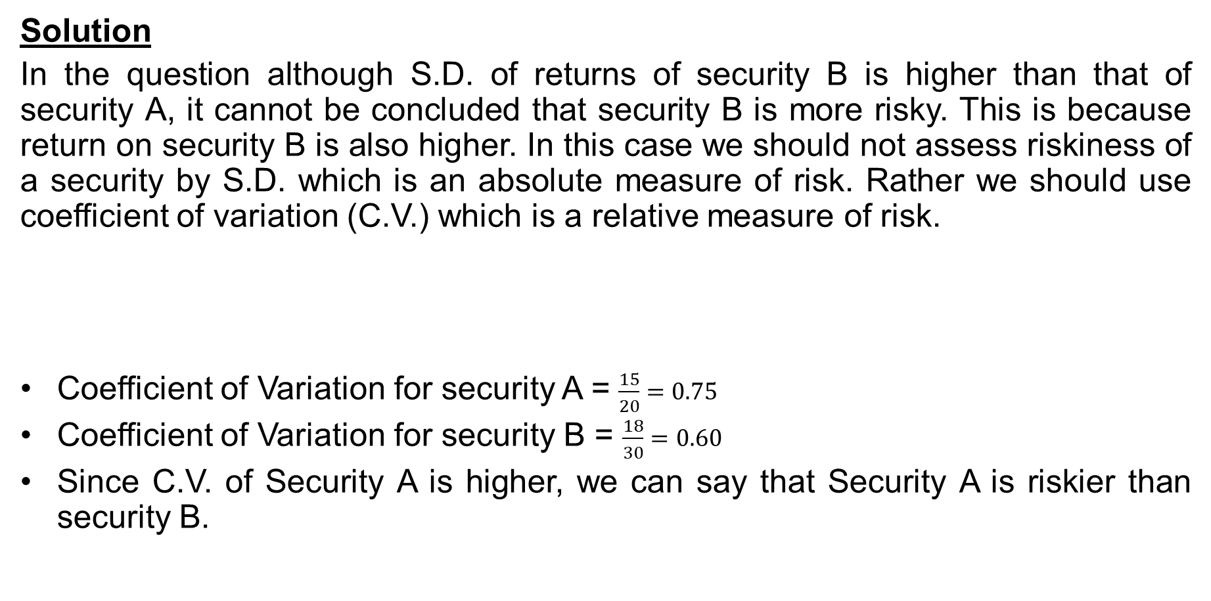
Coefficient of Variation as a relative measure of Risk
Solution
In the question although S.D. of returns of security B is higher than that of security A, it cannot be concluded that security B is more risky. This is because return on security B is also higher. In this case we should not assess riskiness of a security by S.D. which is an absolute measure of risk. Rather we should use coefficient of variation (C.V.) which is a relative measure of risk.
Coefficient of Variation for security A = $\frac{15}{20}=0.75$
Coefficient of Variation for security B = $\frac{18}{30}=0.60$
Since C.V. of Security A is higher, we can say that Security A is riskier than security B.
$$Coefficient of Variation=\frac{Standard Deviation}{Mean Returns}$$

Slide 42
Components of Risk
Risk
Systematic Risk
Market Risk
Interest Rate Risk
Unsystematic Risk
Business Risk
Purchasing Power Risk
Financial Risk

Slide 43
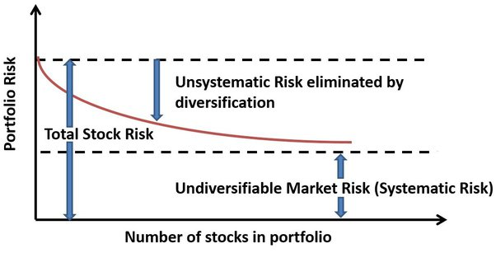
Relation between Total Risk, Systematic Risk and Unsystematic Risk
$$Total Risk \text{= }\text{Systematic} \text{risk}\text{ + }\text{Unsystematic} \text{risk}$$

Slide 44


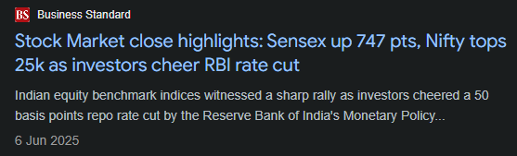
Systematic Risk
The portion of the variability of return of a security that is caused by external factors, is called systematic risk.
It is also known as market risk or non-diversifiable risk.
Systematic risk- uncontrollable by an organization and macro in nature.
Economic and political instability, economic recession, macro policy of the government, etc. affect the price of all shares systematically.
Thus, the variation of return in shares, which is caused by these factors, is called systematic risk.

Slide 45
Types of Systematic Risks
Different types of systematic risks are:
1. Market risk
3. Purchasing power or inflationary risk.
2. Interest rate risk,

Slide 46

Market Risk
Market risk is associated with consistent fluctuations seen in the trading price of any particular shares or securities.
That is, it arises due to rise or fall in the trading price of listed shares or securities in the stock market.
Market risk is caused due to herd-mentality of investors i.e. the tendency of investors to follow the direction of the market.
Hence market risk is the tendency of security prices to move together.
If the market is falling then even good performing companies’ shares fall in prices.
Thus, decline in share price due to market factors is termed as market risk.

Slide 47
Interest Rate Risk
Interest-rate risk arises due to variability in the interest rates from time to time.
It particularly affects debt securities as they carry the fixed rate of interest.
Because fixed income securities like bonds and debentures have a negative relationship with the bond price.
An increase in market interest rate causes bond prices to fall and vice versa.
The types of interest-rate risk are depicted
Price risk and
Reinvestment rate risk.
Price risk arises due to the possibility that the price of the securities, investments, etc. may decline or fall in the future.
Reinvestment rate risk results from fact that the interest or dividend earned from an investment can't be reinvested with the same rate of return as it was acquiring earlier.

Slide 48
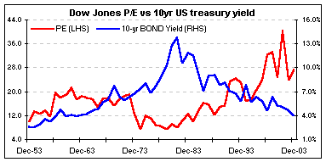
Interest Rate Risk

Slide 49
Interest Rate Risk
If price risk is negative (i.e. fall in price), reinvestment risk would be positive (i.e. increase in earnings on reinvested money).
Price risk is the risk associated with changes in the price of a security due to changes in interest rate.
It must be noted that bond prices are inversely related to interest rates as given :
$$Bond Prices=\frac{Coupon rate}{Market Interest Rate}∗Par Value of Bond$$

Slide 50
Interest Rate Risk
For example, A bond issued at par Rs.1000 has 5 year maturity and a coupon rate of 10% p.a. Now, if the market interest rate increases to 12%, we will not find any buyer for this bond at Rs.1000 because the bond will provide interest income at 10% rate while the market interest rate is 12%. Therefore this bond becomes attractive only at a price lower than Rs.1000. Using the formula, the price if the bond will be Rs. 833.33. This fall in price is interest rate risk.

Slide 51
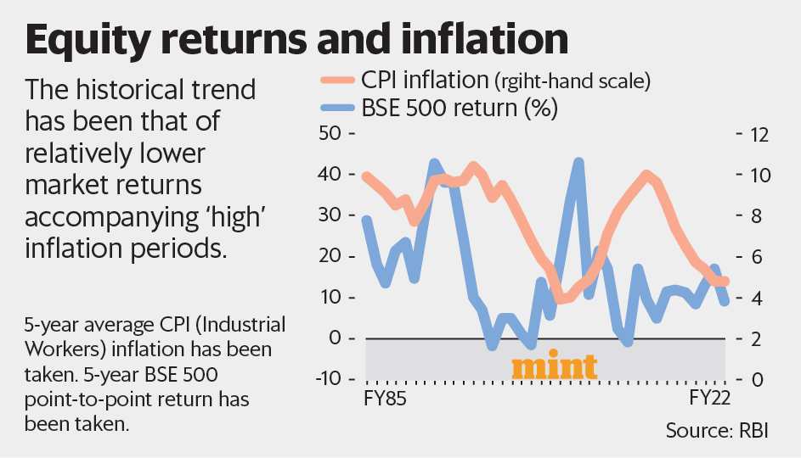
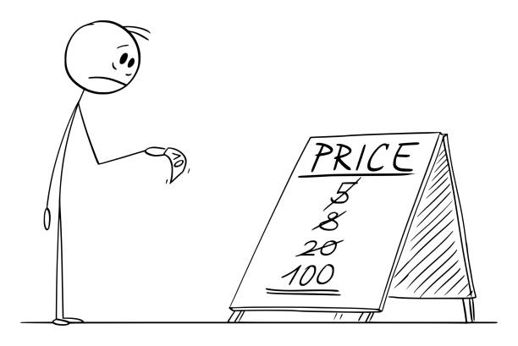
Purchasing Power or Inflationary Risk
Purchasing power risk arises due to inflation.
Inflation is persistent and sustained increase in general price level.
Inflation erodes the purchasing power of money i.e. the same amount of money can buy fewer goods and services due to increase in prices.
Therefore if investor’s income does not increase in times of rising inflation, then the investor is actually getting lower and lower income in real terms.
Fixed income securities are subject to high level of purchasing power risk because income from such securities is fixed in nominal terms.
For example, if the interest from the debenture is 5% and the inflation rate in the economy is 8%, then the investor will generate a negative return of 3%.

Slide 52
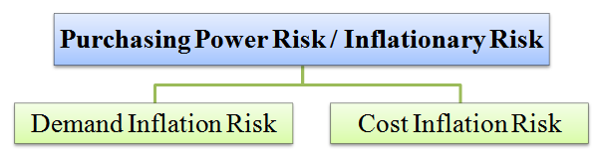
Purchasing Power or Inflationary Risk
Demand inflation risk arises due to increase in price, which result from an excess of demand over supply. It occurs when supply fails to cope with the demand and hence cannot expand anymore. In other words, demand inflation occurs when production factors are under maximum utilization.
Cost inflation risk arises due to sustained increase in the prices of goods and services. It is actually caused by higher production cost. A high cost of production inflates the final price of finished goods consumed by people.

Slide 53

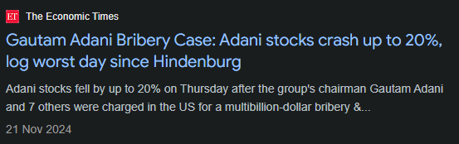
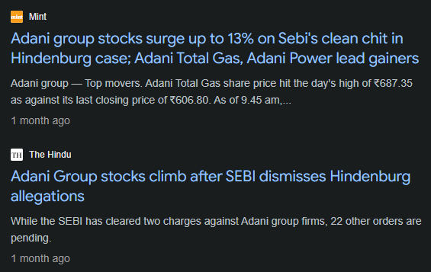

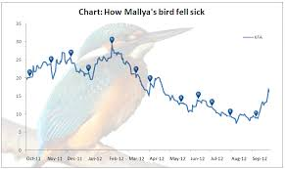
Unsystematic Risk

Slide 54
Unsystematic Risk
The return from a security sometimes varies because of certain factors affecting only the company issuing such security.
Examples are raw material scarcity, Labour strike, management efficiency etc.
Unsystematic risk- controllable by an organization and micro in nature.
It is a micro in nature as it affects only a particular organization.
It can be planned, so that necessary actions can be taken by the organization to mitigate (reduce the effect of) the risk.

Slide 55
Unsystematic Risk
When variability of returns occurs because of such firm-specific factors, it is known as unsystematic risk.
Examples of unsystematic risk include a new competitor in the marketplace with the potential to take significant market share from the company invested in, a regulatory change (which could drive down company sales), a shift in management, or a product recall.

Slide 56
Business Risk
Business risk is measured by the degree of operating leverage (DOL). Degree of operating leverage measures the resultant change in operating income due to a change in its sales revenue.
When fixed operating costs are present in the cost structure of a company then a given change in sales causes more than proportionate change in operating income.
Operating risk arises when DOL > 1. The higher the degree of operating risk the greater will be the business risk.

Slide 57
Business Risk
Business risk is measured by the degree of operating leverage (DOL). Degree of operating leverage measures the resultant change in operating income due to a change in its sales revenue.
When fixed operating costs are present in the cost structure of a company then a given change in sales causes more than proportionate change in operating income.
Operating risk arises when DOL > 1. The higher the degree of operating risk the greater will be the business risk.

Slide 58
Financial Risk
Financial risk is associated with financing decision or capital structure of a company.
It arises due to the presence of interest component or fixed financial cost in the capital structure of a company.
As a result, a change in operating profit will have a more than proportionate change in its earnings per share (EPS).
It must be noted that interest cost must be paid by the company irrespective of the amount of its operating profit.
Financial risk is measured by the degree of financial leverage (DFL) which is the ratio of change in EPS to change in operating profit of a company.
Financial risk arises whenever DFL > 1.
Therefore, companies using excessive debt capital are subject to high financial risk.

Slide 59
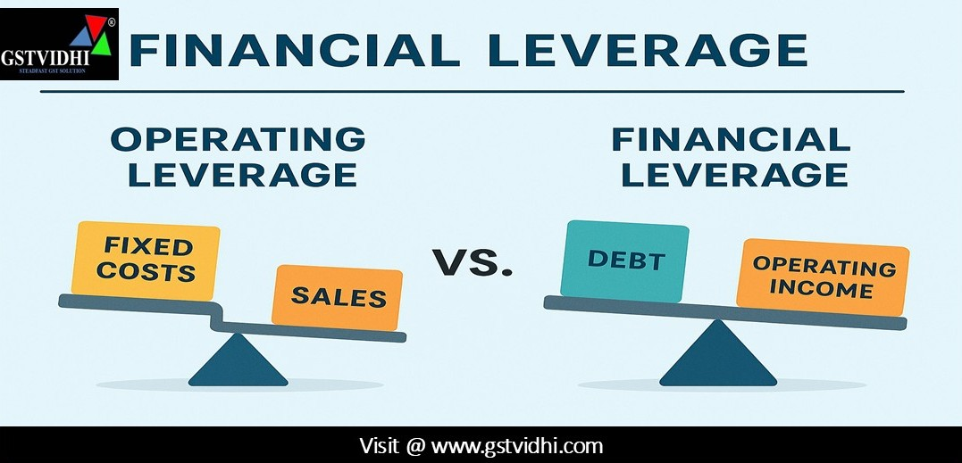
Business Risk vs. Financial Risk

Slide 60
Question
Question
Specify whether the following events are the sources of systematic risk or unsystematic risk.
An increase in oil price by OECD
Labour unrest at Maruti Udyog Ltd.
Break up of Bharati Walmart Joint Venture
Increase in repo rate by RBI.
Debt ridden Kingfisher airlines declares bankruptcy.
Decline in GDP growth rate.
A bad monsoon year.
Corporate mis-governance and management fraud at Satyam Ltd.
COVID-19 crisis.
Depreciation of rupee.

Slide 61
Solution
Specify whether the following events are the sources of systematic risk or unsystematic risk.
An increase in oil price by OECD. - Systematic
Labour unrest at Maruti Udyog Ltd. - Unsystematic
Break up of Bharati Walmart Joint Venture - Unsystematic
Increase in repo rate by RBI. - Systematic
Debt ridden Kingfisher airlines declares bankruptcy. -Unsystematic
Decline in GDP growth rate. - Systematic
A bad monsoon year. - Systematic
Corporate mis-governance and management fraud at Satyam Ltd. - Unsystematic
COVID-19 crisis. -Systematic
Depreciation of rupee.- Systematic

Slide 62
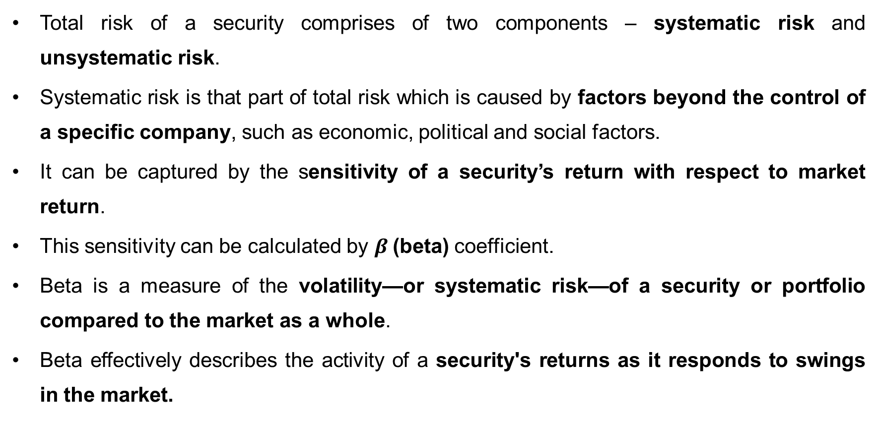
Systematic Risk (Beta)
Total risk of a security comprises of two components – systematic risk and unsystematic risk.
Systematic risk is that part of total risk which is caused by factors beyond the control of a specific company, such as economic, political and social factors.
It can be captured by the sensitivity of a security’s return with respect to market return.
This sensitivity can be calculated by $β$(beta) coefficient.
Beta is a measure of the volatility—or systematic risk—of a security or portfolio compared to the market as a whole.
Beta effectively describes the activity of a security's returns as it responds to swings in the market.

Slide 63
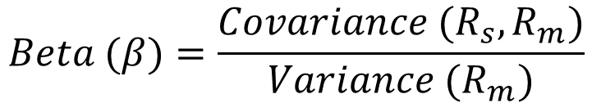
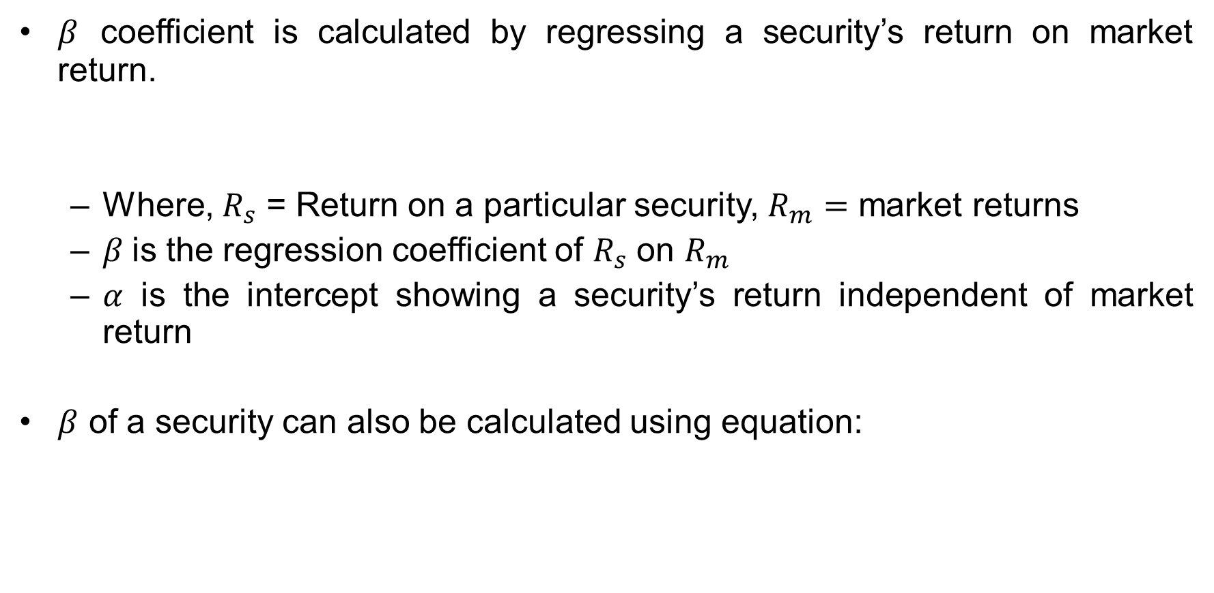

Calculation of Systematic Risk (Beta)
$β$ coefficient is calculated by regressing a security’s return on market return.
Where, $R_{s}$ = Return on a particular security, $R_{m}=$ market returns
$β$is the regression coefficient of $R_{s}$ on $R_{m}$
$α$ is the intercept showing a security’s return independent of market return
$β$ of a security can also be calculated using equation:
$$R_{s}=α+βR_{m}+e$$
$$Beta (β)=\frac{Covariance (R_{s},R_{m})}{Variance (R_{m})}$$

Slide 64
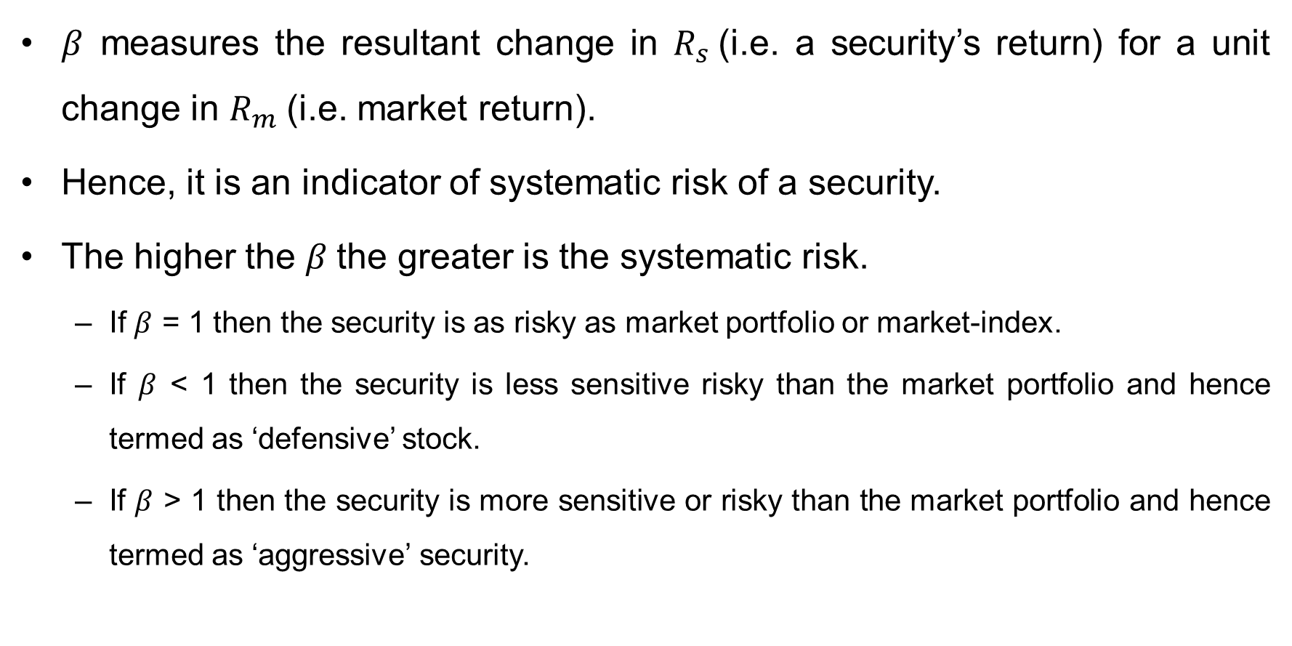
Interpretation of Beta
$β$ measures the resultant change in $R_{s}$(i.e. a security’s return) for a unit change in $R_{m}$(i.e. market return).
Hence, it is an indicator of systematic risk of a security.
The higher the $β$the greater is the systematic risk.
If $β$ = 1 then the security is as risky as market portfolio or market-index.
If $β$ < 1 then the security is less sensitive risky than the market portfolio and hence termed as ‘defensive’ stock.
If $β$ > 1 then the security is more sensitive or risky than the market portfolio and hence termed as ‘aggressive’ security.

Slide 65

Interpretation of Beta
For example, if $β$ = 0.80, then a 10% change in market return will result in 8% change in security return in the same direction.
On the other hand, if $β$ = 1.20, then a 10% change in market return will cause a 12% change in security’s return in the same direction.

Slide 66
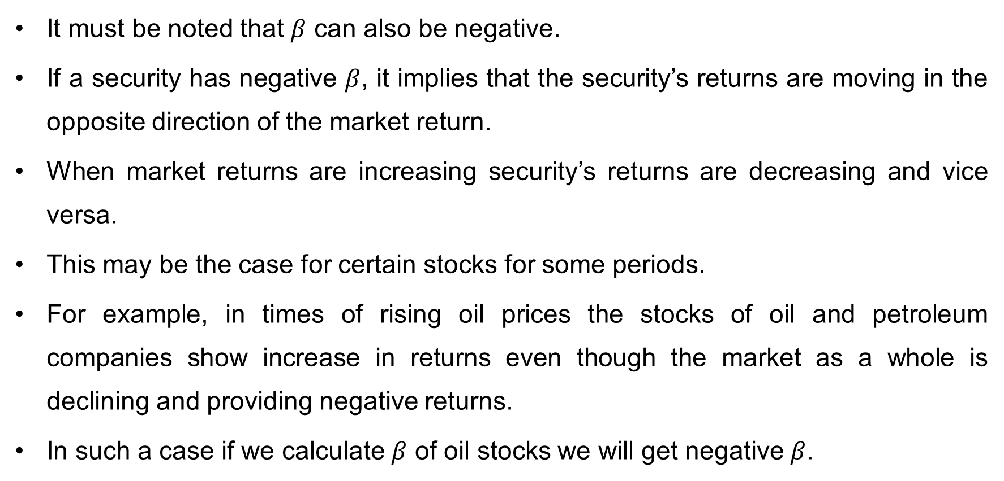
Can Beta be negative?
It must be noted that $β$ can also be negative.
If a security has negative $β$, it implies that the security’s returns are moving in the opposite direction of the market return.
When market returns are increasing security’s returns are decreasing and vice versa.
This may be the case for certain stocks for some periods.
For example, in times of rising oil prices the stocks of oil and petroleum companies show increase in returns even though the market as a whole is declining and providing negative returns.
In such a case if we calculate $β$ of oil stocks we will get negative $β$.

Slide 67
Significance of Beta
Risk measurement: Beta is primarily used to measure the risk associated with an investment. A high beta indicates a higher level of risk, while a low beta indicates lower risk. This information is useful for investors who want to manage their portfolio risk and avoid investments that are overly volatile.
Portfolio construction: Beta can be used in portfolio construction to help investors diversify their investments. By selecting stocks with different betas, investors can create a diversified portfolio that balances risk and return.
Performance evaluation: Beta can be used to evaluate the performance of an investment compared to the overall market. If an investment has a beta of 1, it is expected to move in line with the market. If the investment's beta is less than 1, it is less volatile than the market, and if the beta is greater than 1, it is more volatile than the market.

Slide 68
Significance of Beta
Determining the cost of equity: Beta is used in the Capital Asset Pricing Model (CAPM) to determine the cost of equity. The CAPM formula for the cost of equity is:
Cost of equity = Risk-free rate + Beta * (Expected market return - Risk-free rate)
The beta coefficient measures the systematic risk of a company's equity shares, which is the risk associated with the overall market. The expected market return is the expected return of the market, and the risk-free rate is the rate of return on a risk-free investment, such as government bonds. By using beta in the CAPM formula, the cost of equity can be calculated.

Slide 69
Risk-adjusted measures of portfolio analysis
Some of the popular risk-adjusted measures are:
Sharpe ratio
Treynor’s ratio
Jensen’s alpha

Slide 70
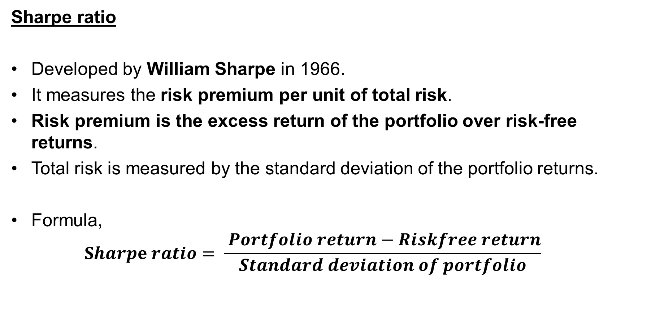
Risk-adjusted measures of portfolio analysis
Sharpe ratio
Developed by William Sharpe in 1966.
It measures the risk premium per unit of total risk.
Risk premium is the excess return of the portfolio over risk-free returns.
Total risk is measured by the standard deviation of the portfolio returns.
Formula,
$$Sharpe ratio= \frac{ Portfolio return−Riskfree return}{Standard deviation of portfolio}$$

Slide 71
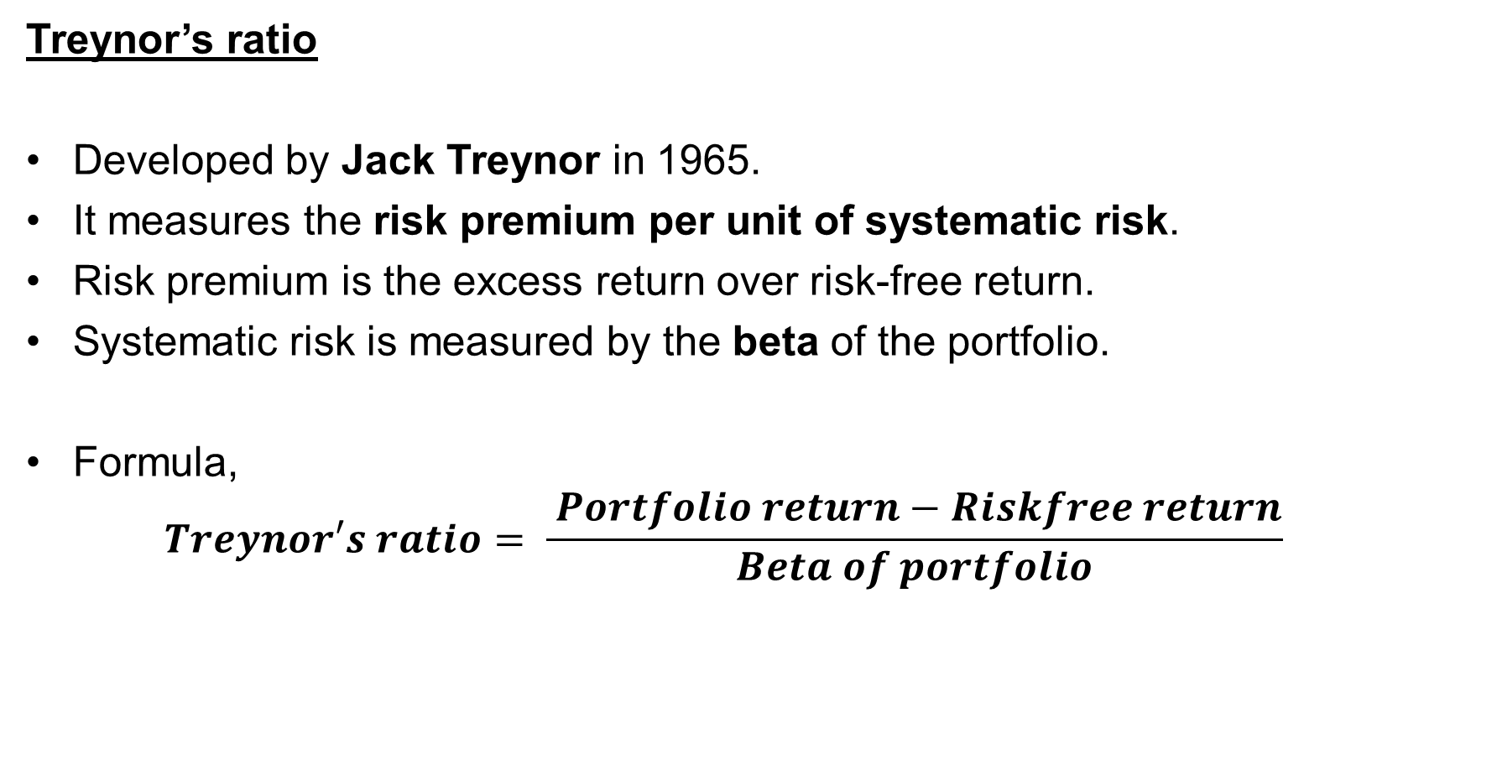
Risk-adjusted measures of portfolio analysis
Treynor’s ratio
Developed by Jack Treynor in 1965.
It measures the risk premium per unit of systematic risk.
Risk premium is the excess return over risk-free return.
Systematic risk is measured by the beta of the portfolio.
Formula,
$$Treynor′s ratio= \frac{ Portfolio return−Riskfree return}{Beta of portfolio}$$

Slide 72
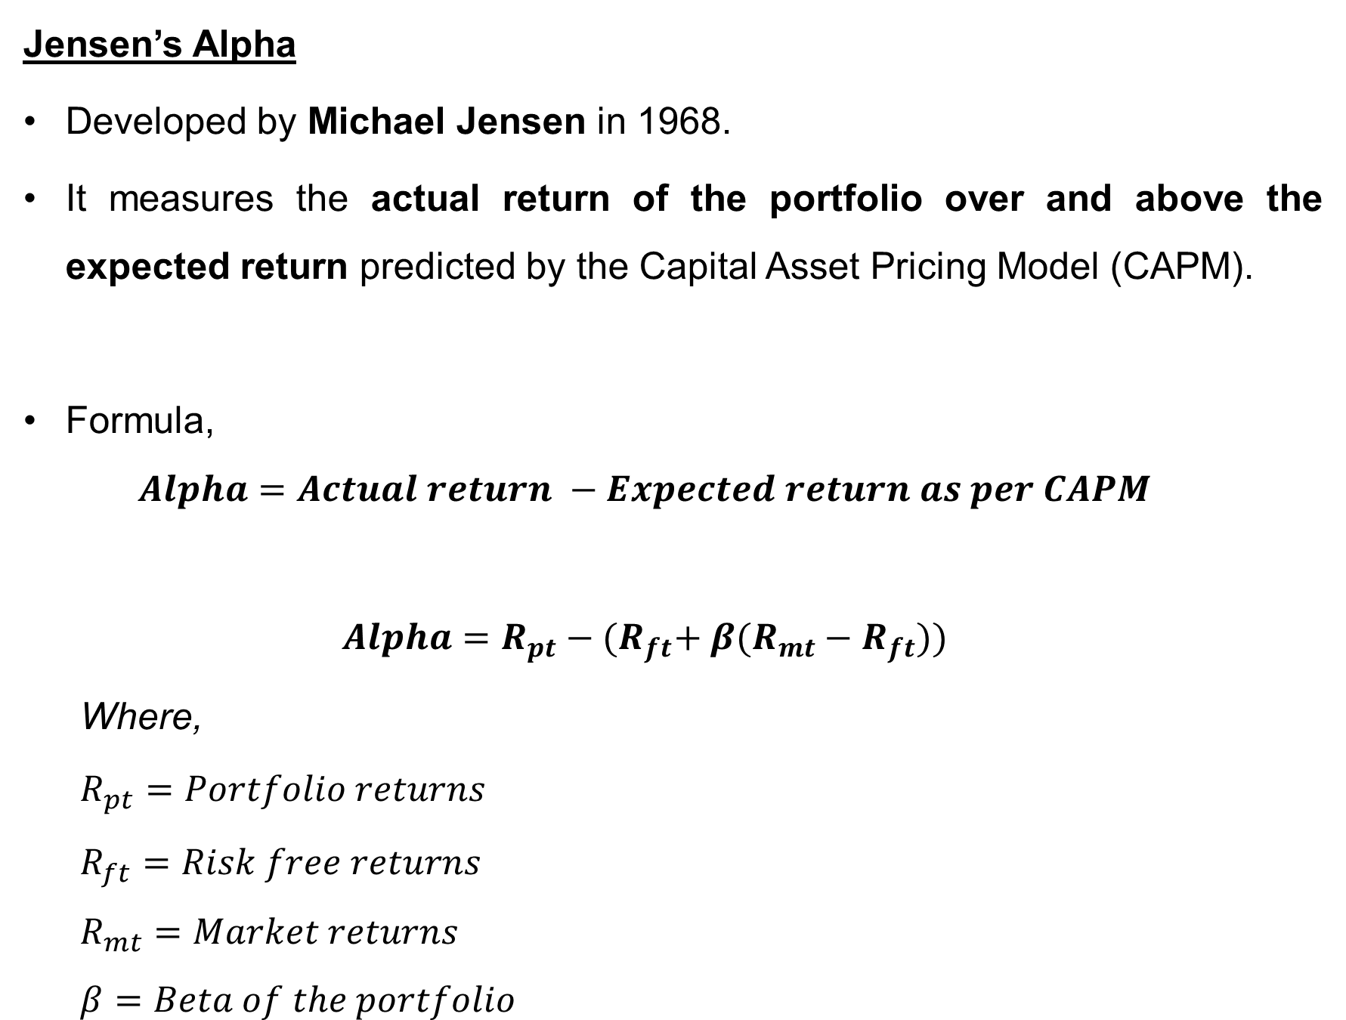
Risk-adjusted measures of portfolio analysis
Jensen’s Alpha
Developed by Michael Jensen in 1968.
It measures the actual return of the portfolio over and above the expected return predicted by the Capital Asset Pricing Model (CAPM).
Formula,
$$Alpha=Actual return −Expected return as per CAPM$$
$$Alpha=R_{pt}−{(R}_{ft}+ β(R_{mt}−R_{ft}))$$
Where,
$$R_{pt}=Portfolio returns$$
$$R_{ft}=Risk free returns$$
$$R_{mt}=Market returns$$
$$β=Beta of the portfolio$$

Slide 73
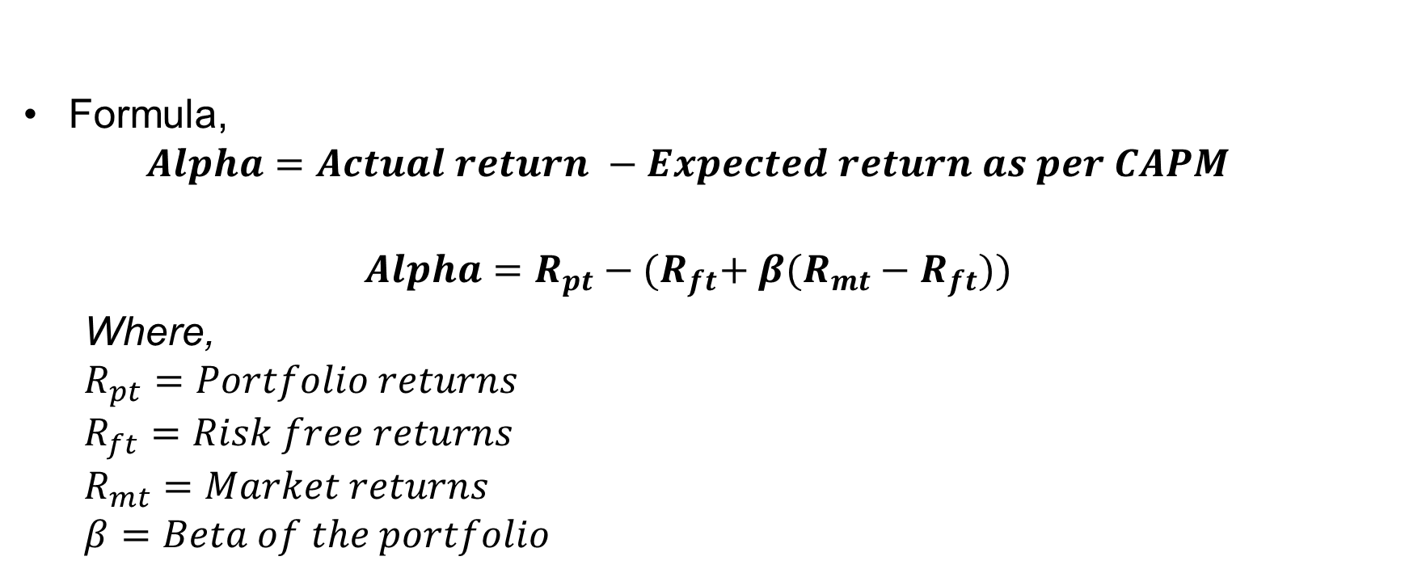
Risk-adjusted measures of portfolio analysis
Formula,
$$Alpha=Actual return −Expected return as per CAPM$$
$$Alpha=R_{pt}−{(R}_{ft}+ β(R_{mt}−R_{ft}))$$
Where,
$$R_{pt}=Portfolio returns$$
$$R_{ft}=Risk free returns$$
$$R_{mt}=Market returns$$
$$β=Beta of the portfolio$$

Slide 74
Questions
Specify whether True/False
Return is the reward for investment.
Risk may be ignored while making investments.
Holding period return can be used to compare two or more investment options.
Average return can be calculated using arithmetic mean.
Calculation of Expected return requires assignment of probabilities to the expected outcomes.
There is no difference between risk and uncertainty.

Slide 75
Questions
Specify whether True/False
7.Beta is an indicator of unsystematic risk
8.Systematic risk is also termed as diversifiable risk.
9.Financial risk is a component of systematic risk.
10.Inefficient management is a source of systematic risk.
11.Beta of a security can never be negative or zero.

Slide 76
Questions
Twelve years ago, Anand paid Rs.12.25 a share for 100 shares of XYZ Ltd. Today, the stock is worth Rs.19 a share. What is Anand’s holding period return for the investment?
What is the HPR for an investor who bought a stock a year ago at Rs.100 and received Rs.15 in dividends over the year, if the stock is now trading at Rs.160?
Which investment performed better? Stock X that was held for three years, during which it appreciated from Rs. 200 to Rs. 250 and provided Rs. 30 in dividends, or Stock Y that went from Rs. 300 to Rs. 420 and generated Rs. 40 in dividends over four years?(Hint: calculate HPR and Annualized Returns)
Compute the expected return and risk for the following X and Y securities?

Slide 77
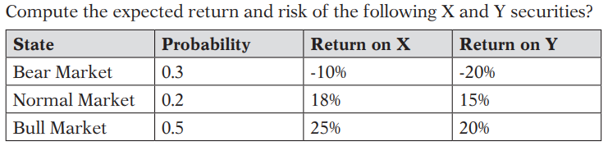
Questions

Slide 78
Questions
5. Mr. Devang, a security analyst wants to analyze the following three securities with respect to risk and return
Can it be concluded that security B is the most risky and security A is the least risky security.
Security | Expected Returns (%) | S.D. of Returns (%)
A | 22 | 15
B | 35 | 20
C | 30 | 18

